Slide 1
SPRIAL MODEL
PRESENTED BY
Afreen
Pooja
Radhika
Eesha
Asfiya

Slide 2
Introduction
Spiral model is one of the most important Software Development Life Cycle models, which provides support for Risk Handling. In its diagrammatic representation, it looks like a spiral with many loops.
The exact number of loops of the spiral is unknown and can vary from project to project. Each loop of the spiral is called a Phase of the software development process.
The exact number of phases needed to develop the product can be varied by the project manager depending upon the project risks. As the project manager dynamically determines the number of phases, so the project manager has an important role to develop a product using the spiral model.
The Radius of the spiral at any point represents the expenses(cost) of the project so far, and the angular dimension represents the progress made so far in the current phase.

Slide 3
Model
Risk Assessment and reduction: The next phase in the cycle is to calculate these various alternatives based on the goals and constraints. The focus of evaluation in this stage is located on the risk perception for the project.
Development and validation: The next phase is to develop strategies that resolve uncertainties and risks. This process may include activities such as benchmarking, simulation, and prototyping.
Planning: Finally, the next step is planned. The project is reviewed, and a choice made whether to continue with a further period of the spiral. If it is determined to keep, plans are drawn up for the next step of the project.
The development phase depends on the remaining risks. For example, if performance or user-interface risks are treated more essential than the program development risks, the next phase may be an evolutionary development that includes developing a more detailed prototype for solving the risks.

Slide 4
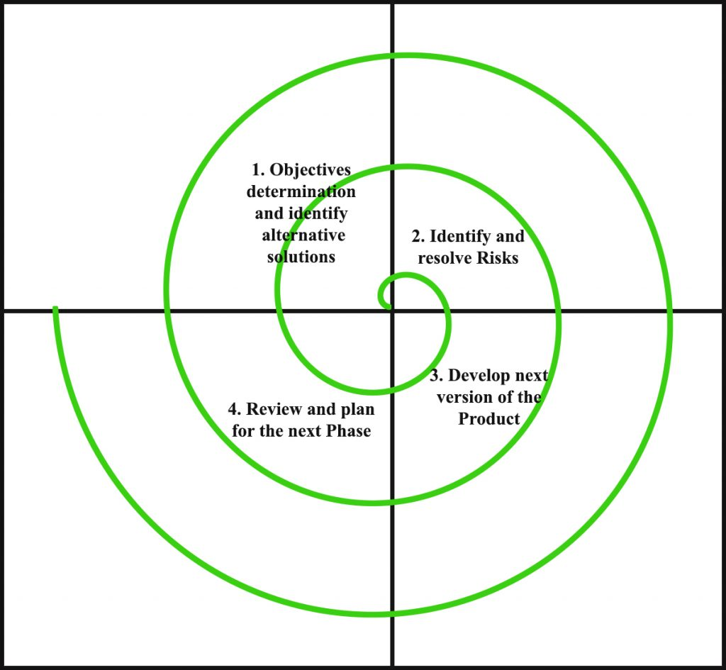
The development phase depends on the remaining risks. For example, if performance or user-interface risks are treated more essential than the program development risks, the next phase may be an evolutionary development that includes developing a more detailed prototype for solving the risks.
The risk-driven feature of the spiral model allows it to accommodate any mixture of a specification-oriented, prototype-oriented, simulation-oriented, or another type of approach. An essential element of the model is that each period of the spiral is completed by a review that includes all the products developed during that cycle, including plans for the next cycle. The spiral model works for development as well as enhancement projects.

Slide 5
MERITS
Risk Managing Feature
Suitable for more extensive projects
Docile in terms of Requirements
Client Satisfaction
Early Estimation of Cost

Slide 6
DMERITS
Difficulty
Expensive
Too much dependability on Risk Analysis:
Difficulty in time management
Complicated in terms of user-friendliness:
Maintenance of prototypes

Slide 7
When to use?
A Spiral model in software engineering is used when project is large.
When releases are required to be frequent, spiral methodology is used.
When creation of a prototype is applicable.
When risk and costs evaluation is important.
Spiral methodology is useful for medium to high-risk projects.

